Slide 1
Evidence Desk Plan Walking Deck
As of January 20, 2015

Slide 2
Environment
Voice of the Customer: Impact of the Microsoft Partner
As we expand our approach to engage both IT and business decision makers, we need to leverage the customer storytelling muscle showcasing the value of partnering with an MPN Partner & why to partner with MPN and Microsoft.
Competitors are better storytellers.
They tell inspiring stories where the business problem is clearly identified, the customer/partner solved it, and the story is told in relevant business terms, not IT jargon.
We have pockets of good storytelling emerging, but it is not the standard across the company.
Competitors are investing heavily in video production.
Google and Salesforce both have YouTube channels with large catalogs of high-quality evidence stories.
Field and audience marketing teams have little to no budget for video production. BGs have video budget and use it for product feature stories, primarily for launch moments. Partner angle is not featured.
We lack powerful partner-customer win stories.
We need to reach both the customer and partner. Customers need to know why to partner with an MPN partner. Partners need to know why they should align with Microsoft.
We need to win the hearts of partners through the transformation with stories of success more often, with more relevancy.

Slide 3
Key strategies
Evidence Desk
Story
Profiling
Collaborate with key content stakeholders to influence the development of key “Why” MPN stories and land them with the partner community to drive engagement
Story
Placement
Validate the inventory of stories for each content priorities to ensure key stakeholders have the right stories to engage our audience
Partner Recruiting for Evidence
Work with communities to target and develop relationships with key influential partners in the ecosystem to tell their story.
Long Term Aspirational
Global Systems
Influence the BG teams in order to modernize the evidence production and publication process* so all partner related story content is centralized for easy access, improved placement rates and ease of future change
*Executive sponsor Kevin Turner & accountability with Jonathan Adashek

Slide 4
Two Evidence Buckets
Why Use an MPN Partner | Why Become an MPN Partner
CUSTOMERS
Customers are engaging in Due Diligence
They have a need for solution
They will explore a slate of options
We will showcase the benefits of using an MPN Partner
PARTNERS
MPN enables partners’ success in a mobile-first, cloud-first world
MPN helps partners to build and maintain profitable businesses
We will showcase how, together, we create new capabilities that expand the market to serve and delight our customers

Slide 5
Opportunity Plan
Where does it Start?
Streamline & Maintain Now
FY15
Grow Resources & Impact
FY16
Long Term Aspiration
FY17 and Beyond
Building belief, providing proof and delivering inspiration that drives engagement with customers and partners through direct story content
Evidence Desk workflow implementation
Managing requests and maintaining current evidence rotations (e.g., EBC, Partner Pivot, Portal needs, etc.)
Curating Vision Keynote evidence needs
Maintaining/Updating MPN Evidence Portal pages
Working with WW Customer Evidence teams to curate & pipeline new evidence leads and opportunities
Providing evidence for current content needs
NEEDS: 20/hr week v- support
BUDGET REQUEST: $50,000
Move from resource desk to story production and sourcing drawing from communities and regions
Reimagine evidence on MPN portal: how it is seen, used, and informs greater impact
Build credibility of MPN and attract/recruit by developing relevant stories globally
Develop PR ready pipeline of stories for greater awareness generation
Drive community engagement → implement toolkit approach for customers and partners to tell their story
NEEDS: 30/hr week v- support
BUDGET: TBD ($150,000)
Move from resource desk to full end-to-end evidence production and facilitation
Reimagine evidence on MPN portal: how it is seen, used, and informs greater impact
Build credibility of MPN through storytelling and attract/recruit by developing relevant stories globally
Drive community engagement → implement toolkit approach for customers and partners to tell their story
Incorporate gamification and investigate integration into overall MPN “benefits” gamification experience
NEEDS: Dedicated v-team support
BUDGET: TBD

Slide 6
MPN customer and partner evidence
FY15 Evidence Desk Program Model
Inbound Evidence Request Workflow
Requestor submits evidence request form on SP host site
PM reviews, triages, and provides recommendation
FTE reviews and approves based on need and usage capabilities
PM packages evidence as a resource summary and uploads to SP host site
Resources are downloaded by Requestor and utilized
Key
Requestor/Submitter
Utilization is tracked and entered into evidence database
Project Manager (V-)
Work Stream Owner (FTE)

Slide 7
MPN customer and partner evidence
FY15 Evidence Desk Program Model
Inbound Evidence Submission Workflow
Submitter submits evidence request form on SP host site
PM packages evidence as resource summary and uploads to SP host site
Weekly Evidence Triage & Opportunity meeting:
Map out new evidence and match to utilization requests and editorial calendar needs
PM identifies usage / updates database PM responds to submitter on next steps: produce or archive
Produce: identify channel for usage and usage requirements to execute.
Notifies submitter or usage.
Key
Requestor/Submitter
Archived: for future review/needs
Project Manager (V-)
Work Stream Owner (FTE)

Slide 8
Execution Plan – Evidence Desk
Deliverable and Resources
Deliverable | Budget | Goals/Metrics
EVIDENCE REQUEST FULFILLMENT process workflow management | $30,000 (20-hour v-) | # of requests managed and fulfilled
EVIDENCE SUBMISSION process workflow management |  | # of new stories identified and added to database
PARTNER RECRUITING: Identify and target list of key, influential partners |  | # of partners recruited/identified for evidence projects
STORY PROFILING: (5) new case study write-ups, partner focused, rooted in O365, CRM Online, and Azure success | $20,000 | # of new case study write-ups # of visitors/views
STORY PLACEMENT: EBC, MPN Portal, Partner Pivot, Stories Project, fulfill other ancillary MPN team needs, WPC vision keynote | $0
Dependencies
Dependency | Desired Outcome
Influencer Communities | Target partner influencers within our communities (both digital and offline) and develop relationships to understand wins and accelerator moments that need to be highlighted or captured as evidence
Field Community | Field contributions to provide/curate/validate global evidence pieces
MPN Content Stakeholders | Identify opportunities and gaps for content that can be utilized by evidence. Great partner & customer stories that drive partner coearned media coverage Content aligned with the Mobile First. Cloud First. message
BG evidence teams | Shift in storytelling to include voice of partner, topics that align with cloud messaging and new assets needed

Slide 9
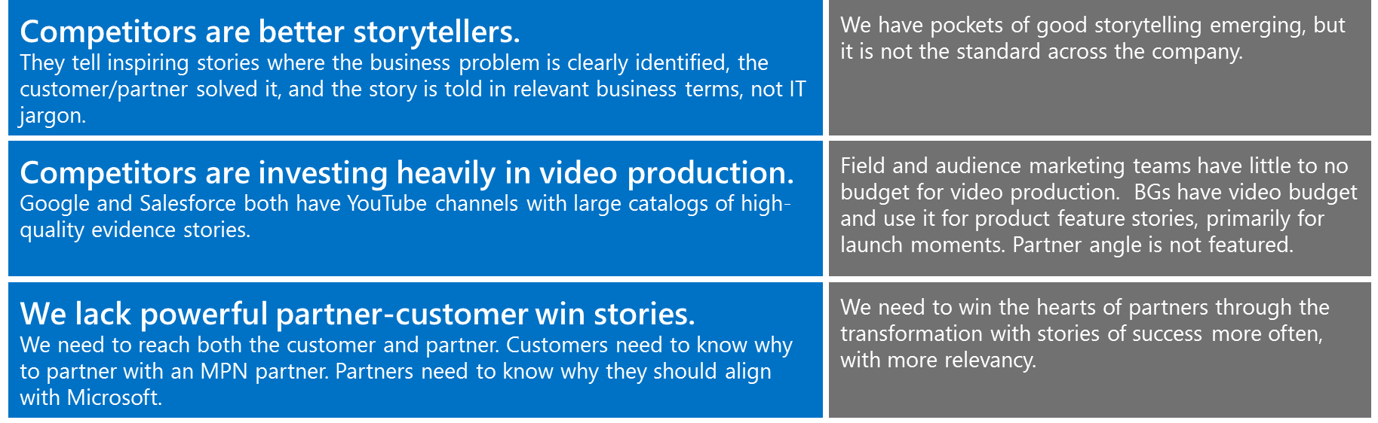
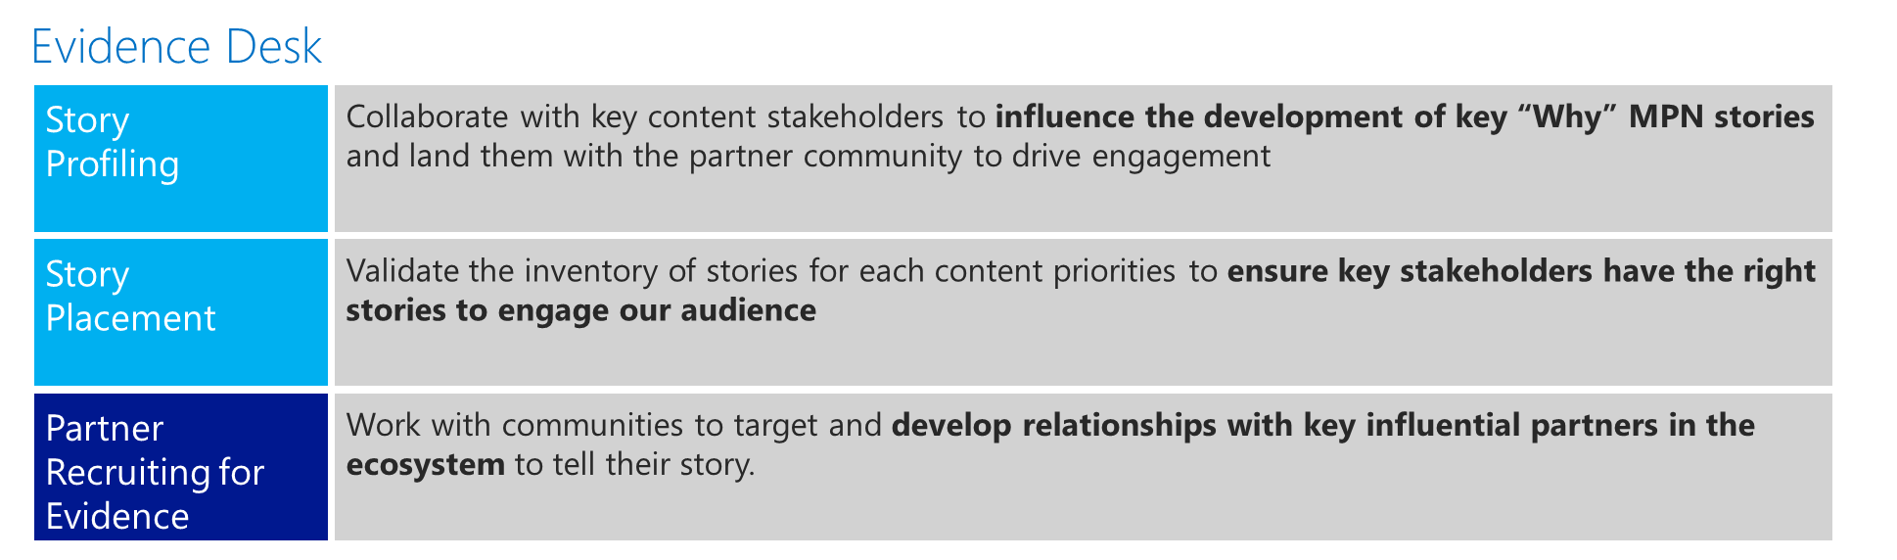
Evidence FY15 Business Plan Summary
w
1
Goals | Approach | Outcomes
Identify, engage, and amplify advocates Engage and inspire through customer & partner stories Illustrate success & profitability momentum by partnering with MPN | Implement process and rigor around evidence workflow Act as centralized source for content stakeholders to utilize evidence to strengthen content and value prop Influence placement of stories in owned media | Workflow implementation Executing with SLAs for managing requests and output deliverables Curating vision keynote and other evidence stories for WPC Maintaining existing MPN evidence (i.e., Portal, EBC, etc.)
2
Mental Model:
Becoming better storytellers…
3
Key Strategy | Tactics/Deliverables | FY14 Investment | Metrics
Drive infrastructure improvements | Build a workflow management model to process evidence request fulfillment and evidence submissions | $30,000 20 hour v- | # of requests managed and fulfilled
Support placement of stories on owned media | Regular check ins with content leads to support and identify key evidence materials to support story needs |  | # of new stories identified and added to database
Influence storytelling topics, assets and landing | Engage with content stakeholders across MPN to align key evidence and anchor content with value prop. Engage across Microsoft with evidence leads to identify and influence the partner angle for story development and landing | $20,000 Case studies | # of new partners identified/recruited for evidence projects/case studies/content # of new case study write-ups # of visitors/views

Slide 10
How do you envision this process working?
Internal - what would make accessing and using evidence easy for you?
Lead database
Managed for usage justification – Sign up to be part of alias – when new evidence comes in the que that you’re interested in, you are notified
Ready-to-go assets
Easily accessible, quick stop shot

Slide 11
How do you envision this process working?
External - what would make accessing and using evidence easy for MPN?
A centralized, cohesive external facing site within the MPN portal, with ‘search and sort’ capabilities, something ‘all up’ for partners
2 Buckets:
Lead database – managed for usage justification, not a free for all
Sign up to be part of alias – and when new evidence comes in the que that you’re interested in, you are notified.
Ready to go assets – easily assessable, quick stop shop
Land the Partner directly on page
Collaborate with key content stakeholders to influence the development of key “Why” MPN stories and land them with the partner community to drive engagement
Who should have access?
Internal / External/Should it be limited or not?

Slide 12
Current Evidence Work Being Done
What we’ve just accomplished – where does the evidence live?
Cloud Profitability page
Lives on MPN - specifically for videos and written case studies
Public Sector Evidence Finder
The output query identifies partner

Slide 13
How do we make this functional?
How do we create a tracking system?
Must Have
There is a need for fresh partners to talk to / need for partners that fit a certain criteria or profile /Pipeline database of past evidence, back 6 months to one year or further – so we can track resource base and being able to identify usage / Also very important to track, renew release waivers in tandem with evidence usage / are the partner’s competencies current?
Nice to Have
If a partner is already being contacted, can we create a list of ‘30 questions’ – explore this idea, might not be practical given the specialized team perspectives, needs
Benefits – would already have their quotes, storyline, journey to the cloud, their evolving business model
Nice to have - Need centralized resource lead (budget) for follow-up on leads, does initial interviewing of partner – builds database – easily assessable, tiered approach of engagement
Aspirational
Also situations where we need to tell the update of a story – process for distinguishing and tracking that

Slide 14
Current Evidence Work Being Done
What evidence is currently being worked on
MPN Stories Project
WPC Partner Pivot
WPC vision keynote
Cloud Profitability transformation stories at the PAC
Partner Workstream Profitability

Slide 15
What kind of assets do you have the greatest need for?
What we’ve just accomplished – where does the evidence live?
Video content (significant budget ask)
Magazine style tool
More partner quotes
Roadmaps
Need to refresh case study format
Infographics
flow diagrams
Framework key points
More visuals
Long form content (Shantel estimated that one story development costs $10,000)
Research more innovation story-telling platforms
Formatted content that’s easy to include in blogs

Slide 16
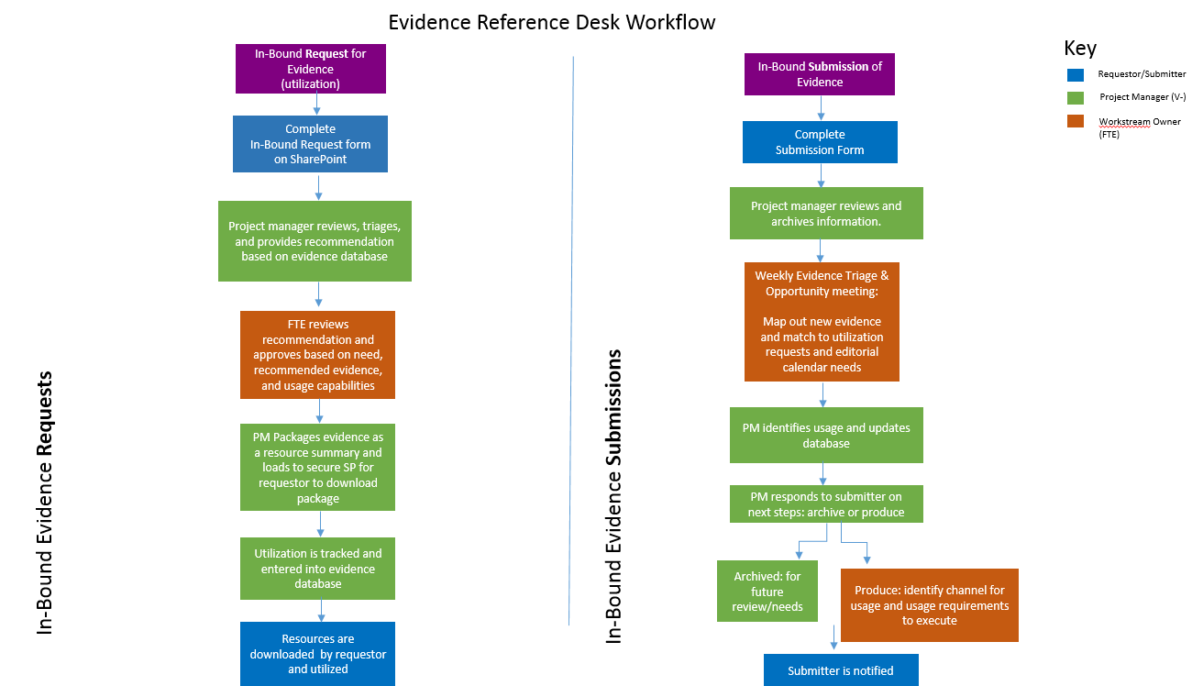
MPN customer and partner evidence
FY15 Evidence Desk program model
Submit Evidence for Review
<click here>

Slide 17
Evidence Reference Desk Workflow
Key
In-Bound Request for Evidence
(utilization)
In-Bound Submission of Evidence
In-Bound Submission of Evidence
Requestor/Submitter
Project Manager (V-)
Complete
In-Bound Request form on SharePoint
Complete
Submission Form
Workstream Owner (FTE)
Complete
Submission Form
In-Bound Evidence Requests
In-Bound Evidence Submissions
Project manager reviews and archives information.
Project manager reviews, triages, and provides recommendation based on evidence database
Project manager reviews and archives information.
Weekly Evidence Triage & Opportunity meeting:
Map out new evidence and match to utilization requests and editorial calendar needs
Weekly Evidence Triage & Opportunity meeting:
Map out new evidence and match to utilization requests and editorial calendar needs
FTE reviews recommendation and approves based on need, recommended evidence, and usage capabilities
PM identifies usage and updates database
PM identifies usage and updates database
PM Packages evidence as a resource summary and loads to secure SP for requestor to download package
PM responds to submitter on next steps: archive or produce
PM responds to submitter on next steps: archive or produce
Utilization is tracked and entered into evidence database
Archived: for future review/needs
Archived: for future review/needs
Produce: identify channel for usage and usage requirements to execute
Resources are downloaded by requestor and utilized
Submitter is notified

Slide 18
What kind of assets do you have the greatest need for?
What we’ve just accomplished – where does the evidence live?
MPN Stories Project – (Shantel) - Long form storytelling for 50 customer cloud stories that will be published between now and mid-fall (many of the stories are rooted in WPC Awards stories) - Shantel shared the link to her project – first 5 stories launched on 4/2, will be launching another story around the 20th of April, on-going 2 week cycle (15 created and launched by June). Have 40 partners identified, 10 slots still open (will look to award winners and WPG Evidence database stories to fill these slots).
Partner angle/pivot – identifying specific customers and taking their perspective on how they were influenced by the work/solutions of our partners. Https://partner.microsoft.com/en-us/stories
WPC Partner Testimonial videos – (Heather) - specifically for WPC – short 15 sec sound-bytes – will be displayed on WPC pages of MPN portal to evangelize the value of the event
WPC Partner Pivot – magazine/editorial style format – showcases the impact WPC has had on an individual partner and their company
WPC vision keynote – (Heather) - main stage video – 3 top stories that land the partner perspective of a transformational/disruptive story highlighting the Cloud evolution
Cloud Profitability transformation stories at the PAC – (I-Chin) - Film crew will be onsite for 2 days; minimum of 5 clips, can do as many as 10-15.
Question was raised asking if I-Chin was working with Christina on this project or if they were 2 separate actions.
I-Chin responded that they are both working on parts of the project that will converge at the PAC.
Noga asked about Christina’s transformation videos, in regards to intersection with her videos.
Shantel responded re: Christina’s team – has video ready now, “Better Cloud Partner”, going live in a couple of weeks through Still-blog; based on how it performs she’s looking at doing some additional blogs on a monthly basis.
Lisa followed up with Christina and document project in Evidence Workstream doc
Christina’s evidence …
Partner Workstream Profitability – (Noga)
CSP – (Noga) - new program, want to make sure partners are aware of it and why they should join, a place to go where they can learn about the program and see partners doing well with it (case studies, videos, infographics)

